Slide 1

Introduction to Speech Information Processing:
A Story of Artificial Intelligence
Berrak Sisman
Assistant Professor
ISTD Pillar, SUTD

Slide 2

Audience can send questions!

Slide 3

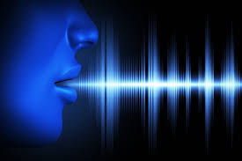



About me
Assistant Professor at ISTD Pillar, SUTD (April 2020 - )
Research field: speech information processing, machine learning, AI
Contact: berrak_sisman@sutd.edu.sg
Office: 1.702-03
Education:
PhD in Electrical & Computer Engineering, National University of Singapore
PhD Exchange at University of Edinburgh, United Kingdom (2019)
Visiting Researcher, RIKEN AIP, Japan (2018)
Researcher/Postdoc @ NUS (2019-2020)
Visiting Researcher @ Columbia University, New York
Notes:
In all of these places, I mostly do speech and ML research.

Slide 4
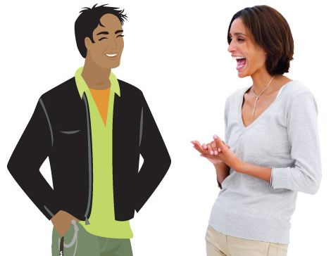
Importance of Speech
Speech is a significant aspect of artificial intelligence. There are many things in AI to be improved by speech research.
Humans communicate through speech.
We express meanings and feelings through speech.
Machines are still unable to do the same in a
human-like manner.
Imagine… A machine with an AI-based high-quality speech technology (understanding/synthesis) will empower many novel products and services, such as intelligent agents, conversational assistants, social robots, movie dubbing and talking heads!

Slide 5
Speech Information Processing
Speech Production
Speech Perception and Psychoacoustics
Speech Analysis
Speech Coding
Speech Enhancement
Speech Recognition
Speech Synthesis and Generation
Voice Separation
Voice Conversion
Acoustic Modeling
Language Modeling
Discourse and Dialogue
Speech Understanding …

Slide 6
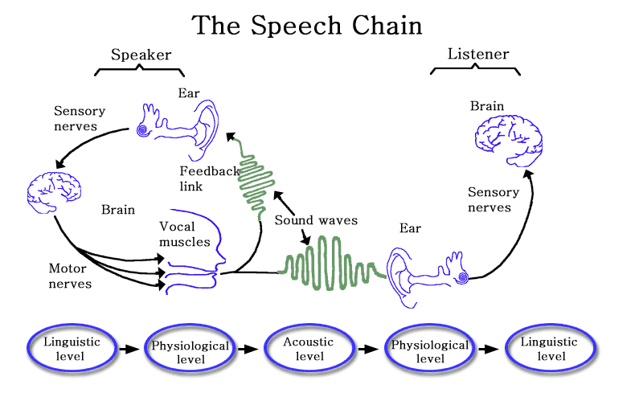
Speech Information Processing
There are 3 subfields of Phonetics, i.e. Articulatory Phonetics, Acoustic Phonetics, and Auditory Phonetics.
* The Speech Chain: The Physics And Biology of Spoken Language, Denes & Pinson (1993)
Notes:
There are speech generation, speech recognition, and speech communication between 2 person (like coding, decoding, transmission etc). This whole thing is called speech chain. Speech information processing is to use AI to emulate every step in this chain to perform human-human & human-machine communication.
In speech generation there is feedback control. When we talk, we also hear what we say.
I would like to say a word (or concept) in our brain it is linguistic level. While we actually say it using lips, mouth and oral organs, it is physiological level. The moment we say, it become a waveform, acoustic signal. Then sound goes to our ear and many physical things happening there, and then we understand the words we hear. Speech processing is to process every step in this chain, and even more.

Slide 7
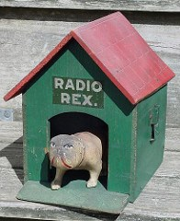
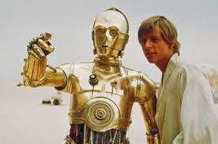
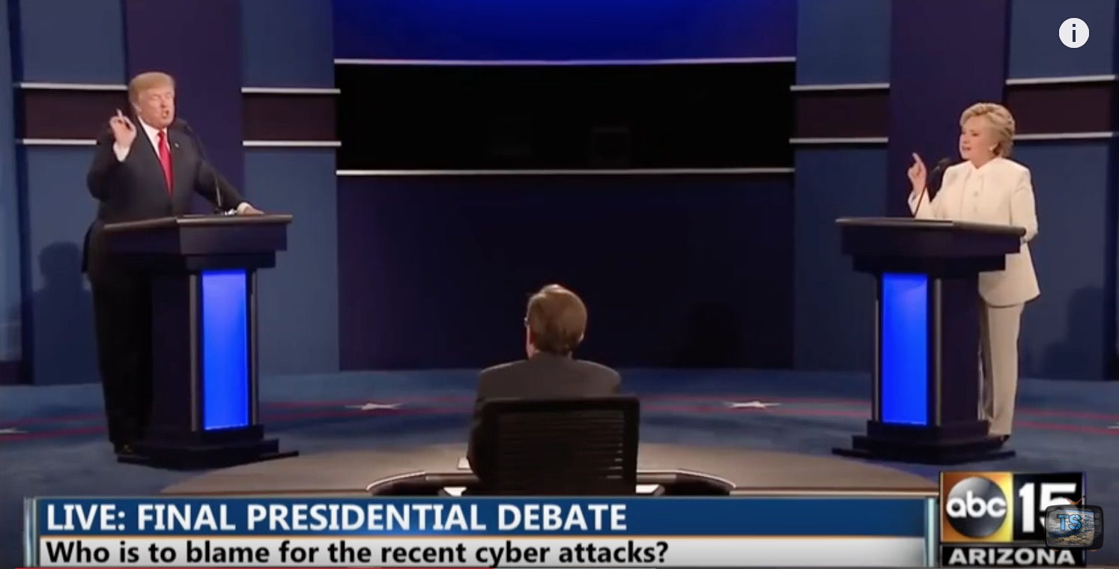

Speech Information Processing
Today, I’ll talk about some of the topics we do research here at ISTD Pillar of SUTD.
Speech Recognition
Speech Synthesis and Generation
Voice Separation
Voice Conversion

Slide 8
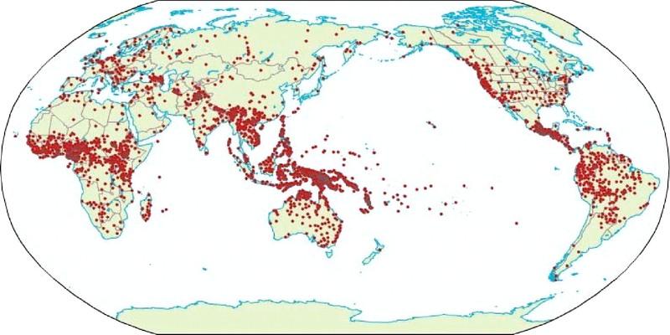
Speech Recognition: Listening Machines
Speech recognition is the ability of a machine or program to identify words and phrases in spoken language and convert them to a machine-readable format
Notes:
South east Asia has lots of languages. Every language requires synthesis and recognition for advanced technology, and actually to perform recognition and synthesis; we may need to use different approaches for different languages. For example synthezing a tonal language (Chinese, Vietnamese…) is actually very different than synthesizing English.
For example: Recognition & synthesis… In English: different tones are considered noise, where as in Chinese it is a crucial information. In Chinese synthesis, we try to model different tones, while in English we do not do this.
We’re in Singapore where many languages are spoken. So we need speech technologies to ease our life in many aspects.

Slide 9
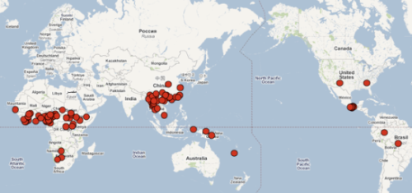
Speech Recognition: Listening Machines
Speech recognition is the ability of a machine or program to identify words and phrases in spoken language and convert them to a machine-readable format
Languages of the World
Each dot represents the geographic center of the 6,912 living languages in the Ethnologue database.
Gordon, Raymond G., Jr. (ed.), 2005. Ethnologue: http://www.ethnologue.com/.
Tonal Language of the World
Notes:
South east Asia has lots of languages. Every language requires synthesis and recognition for advanced technology, and actually to perform recognition and synthesis; we may need to use different approaches for different languages. For example synthezing a tonal language (Chinese, Vietnamese…) is actually very different than synthesizing English.
For example: Recognition & synthesis… In English: different tones are considered noise, where as in Chinese it is a crucial information. In Chinese synthesis, we try to model different tones, while in English we do not do this.
We’re in Singapore where many languages are spoken. So we need speech technologies to ease our life in many aspects.

Slide 10

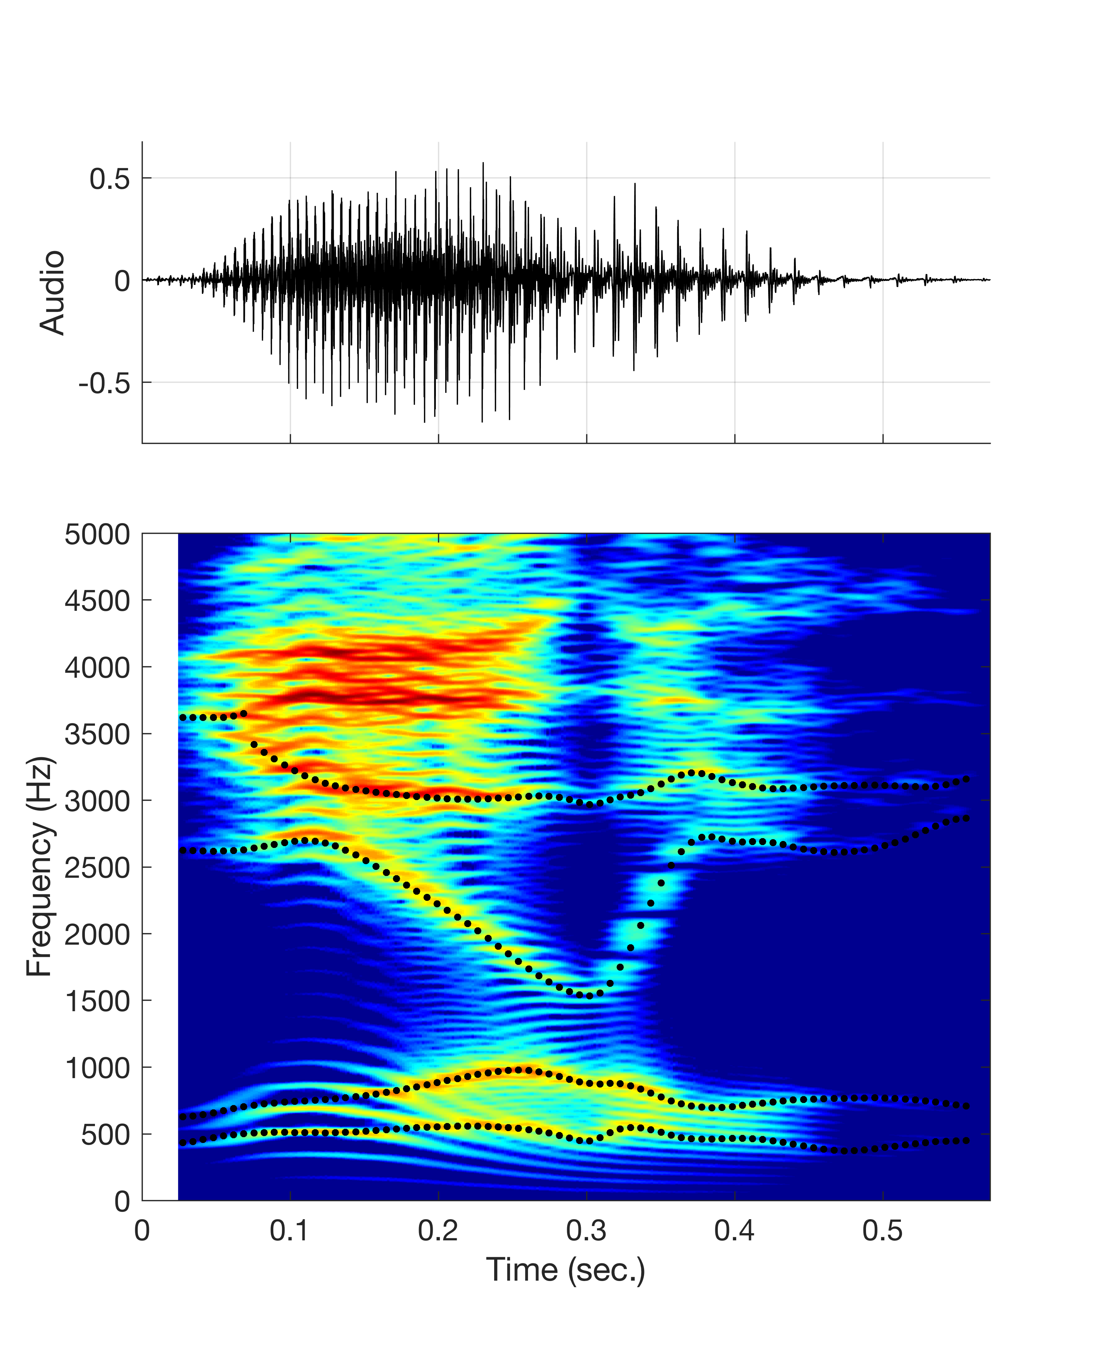
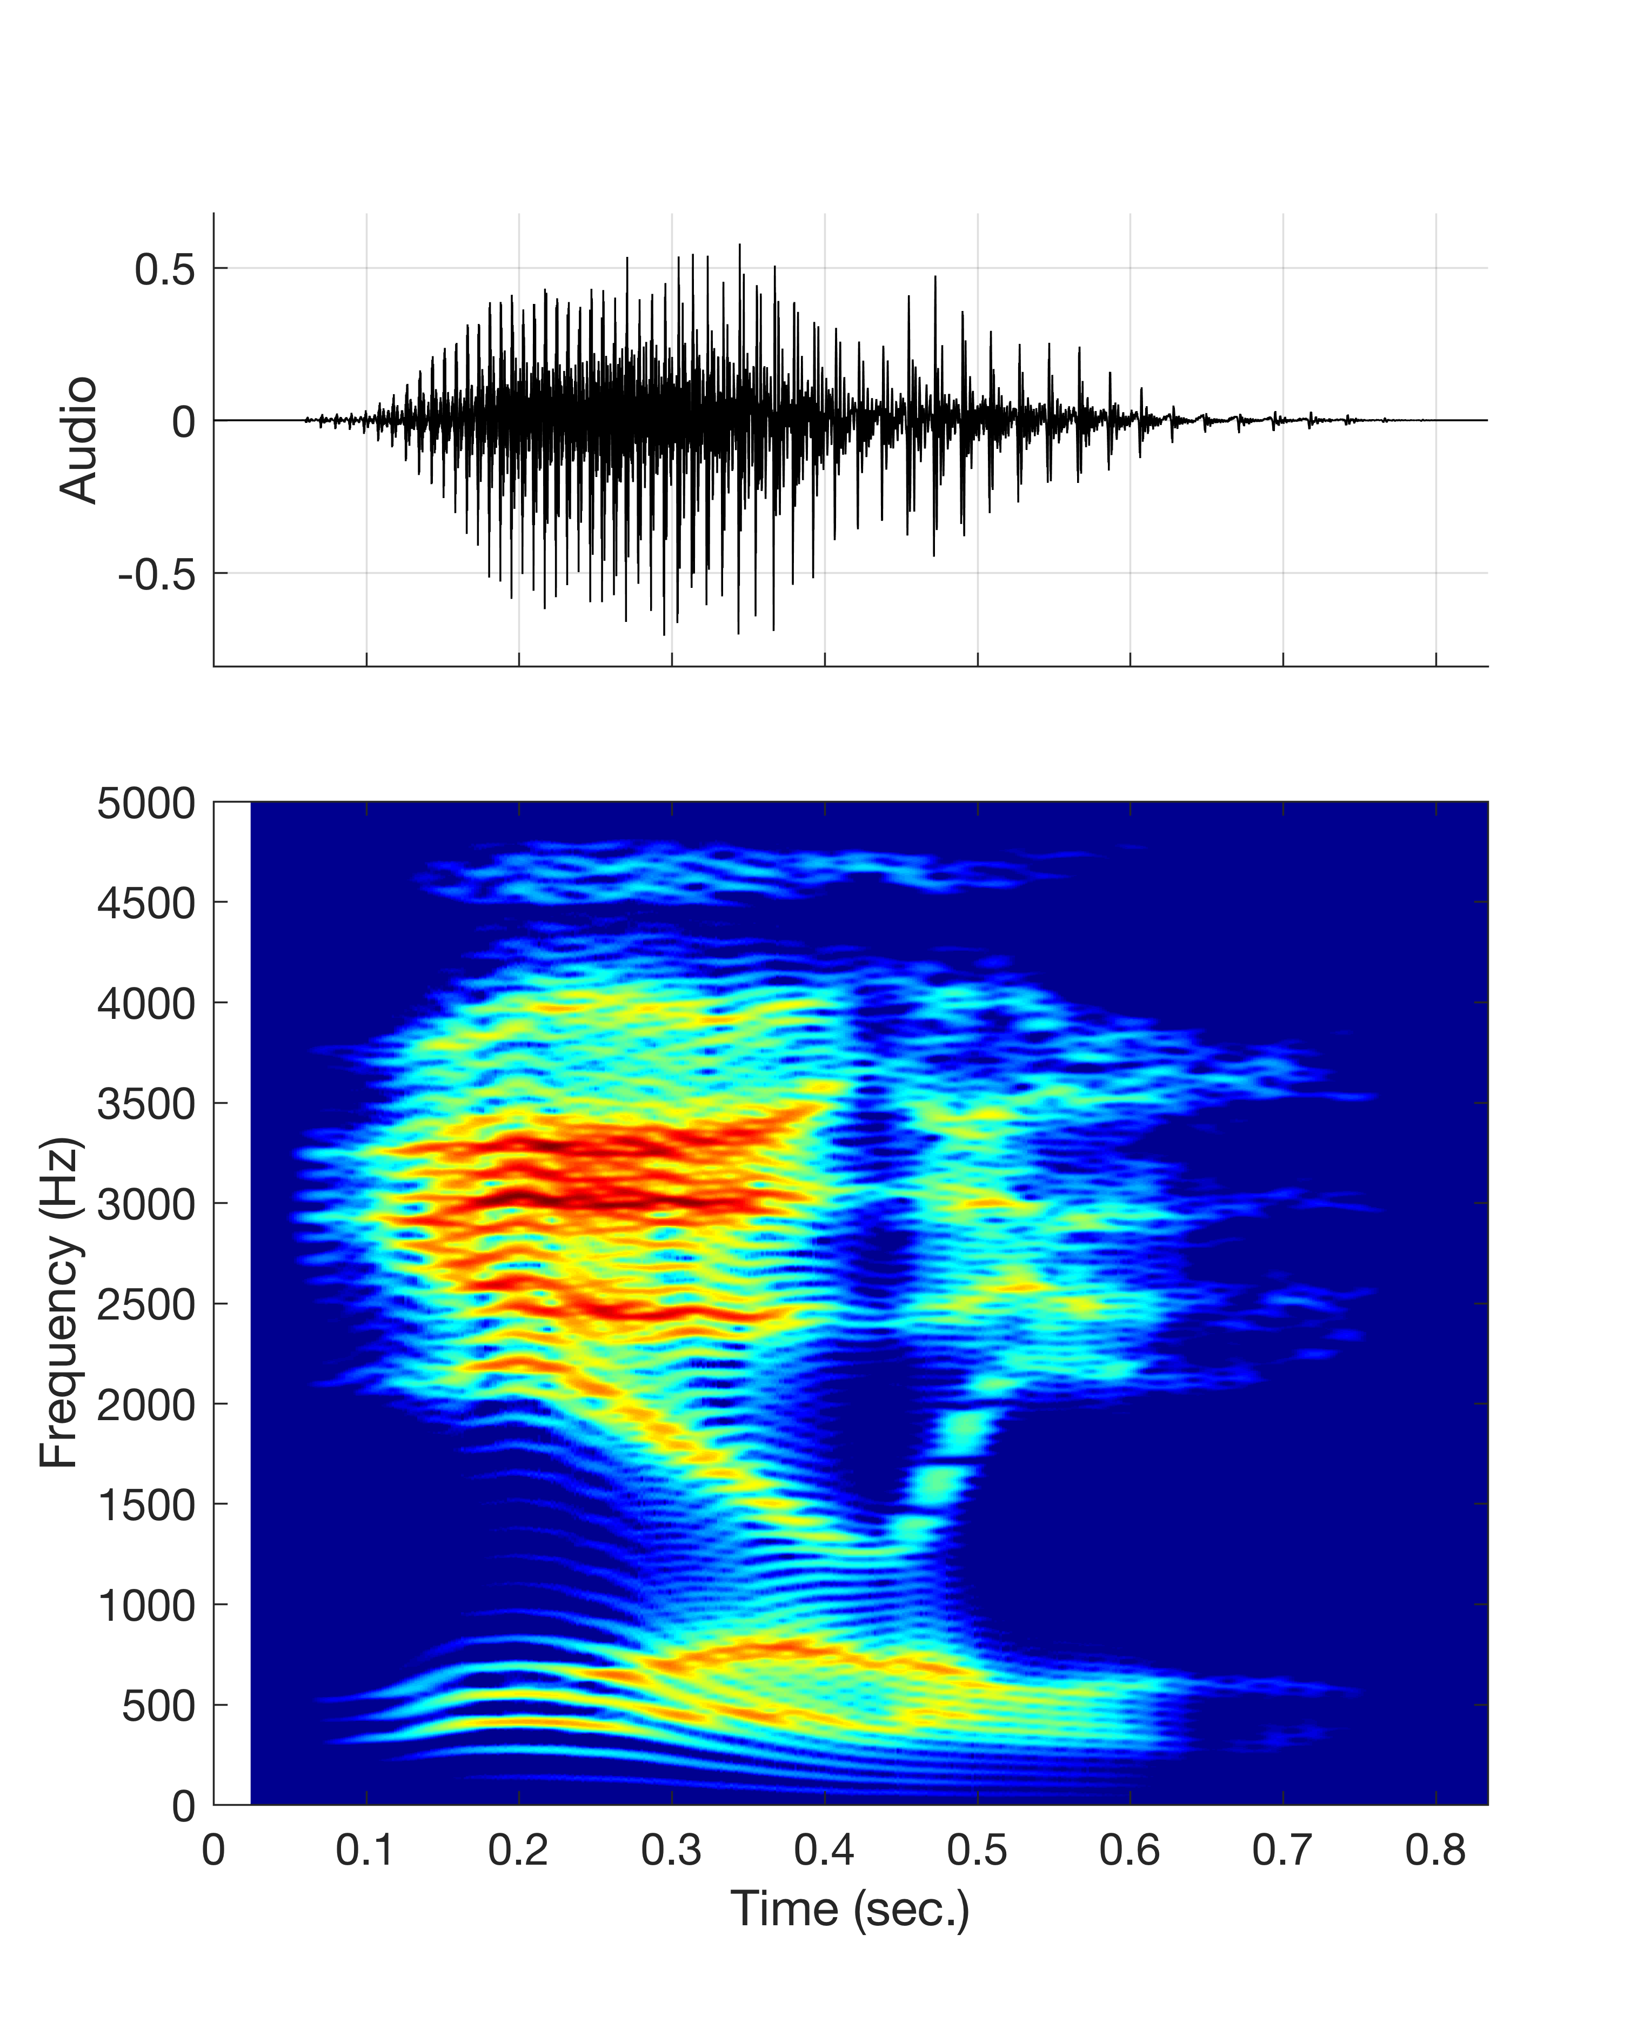
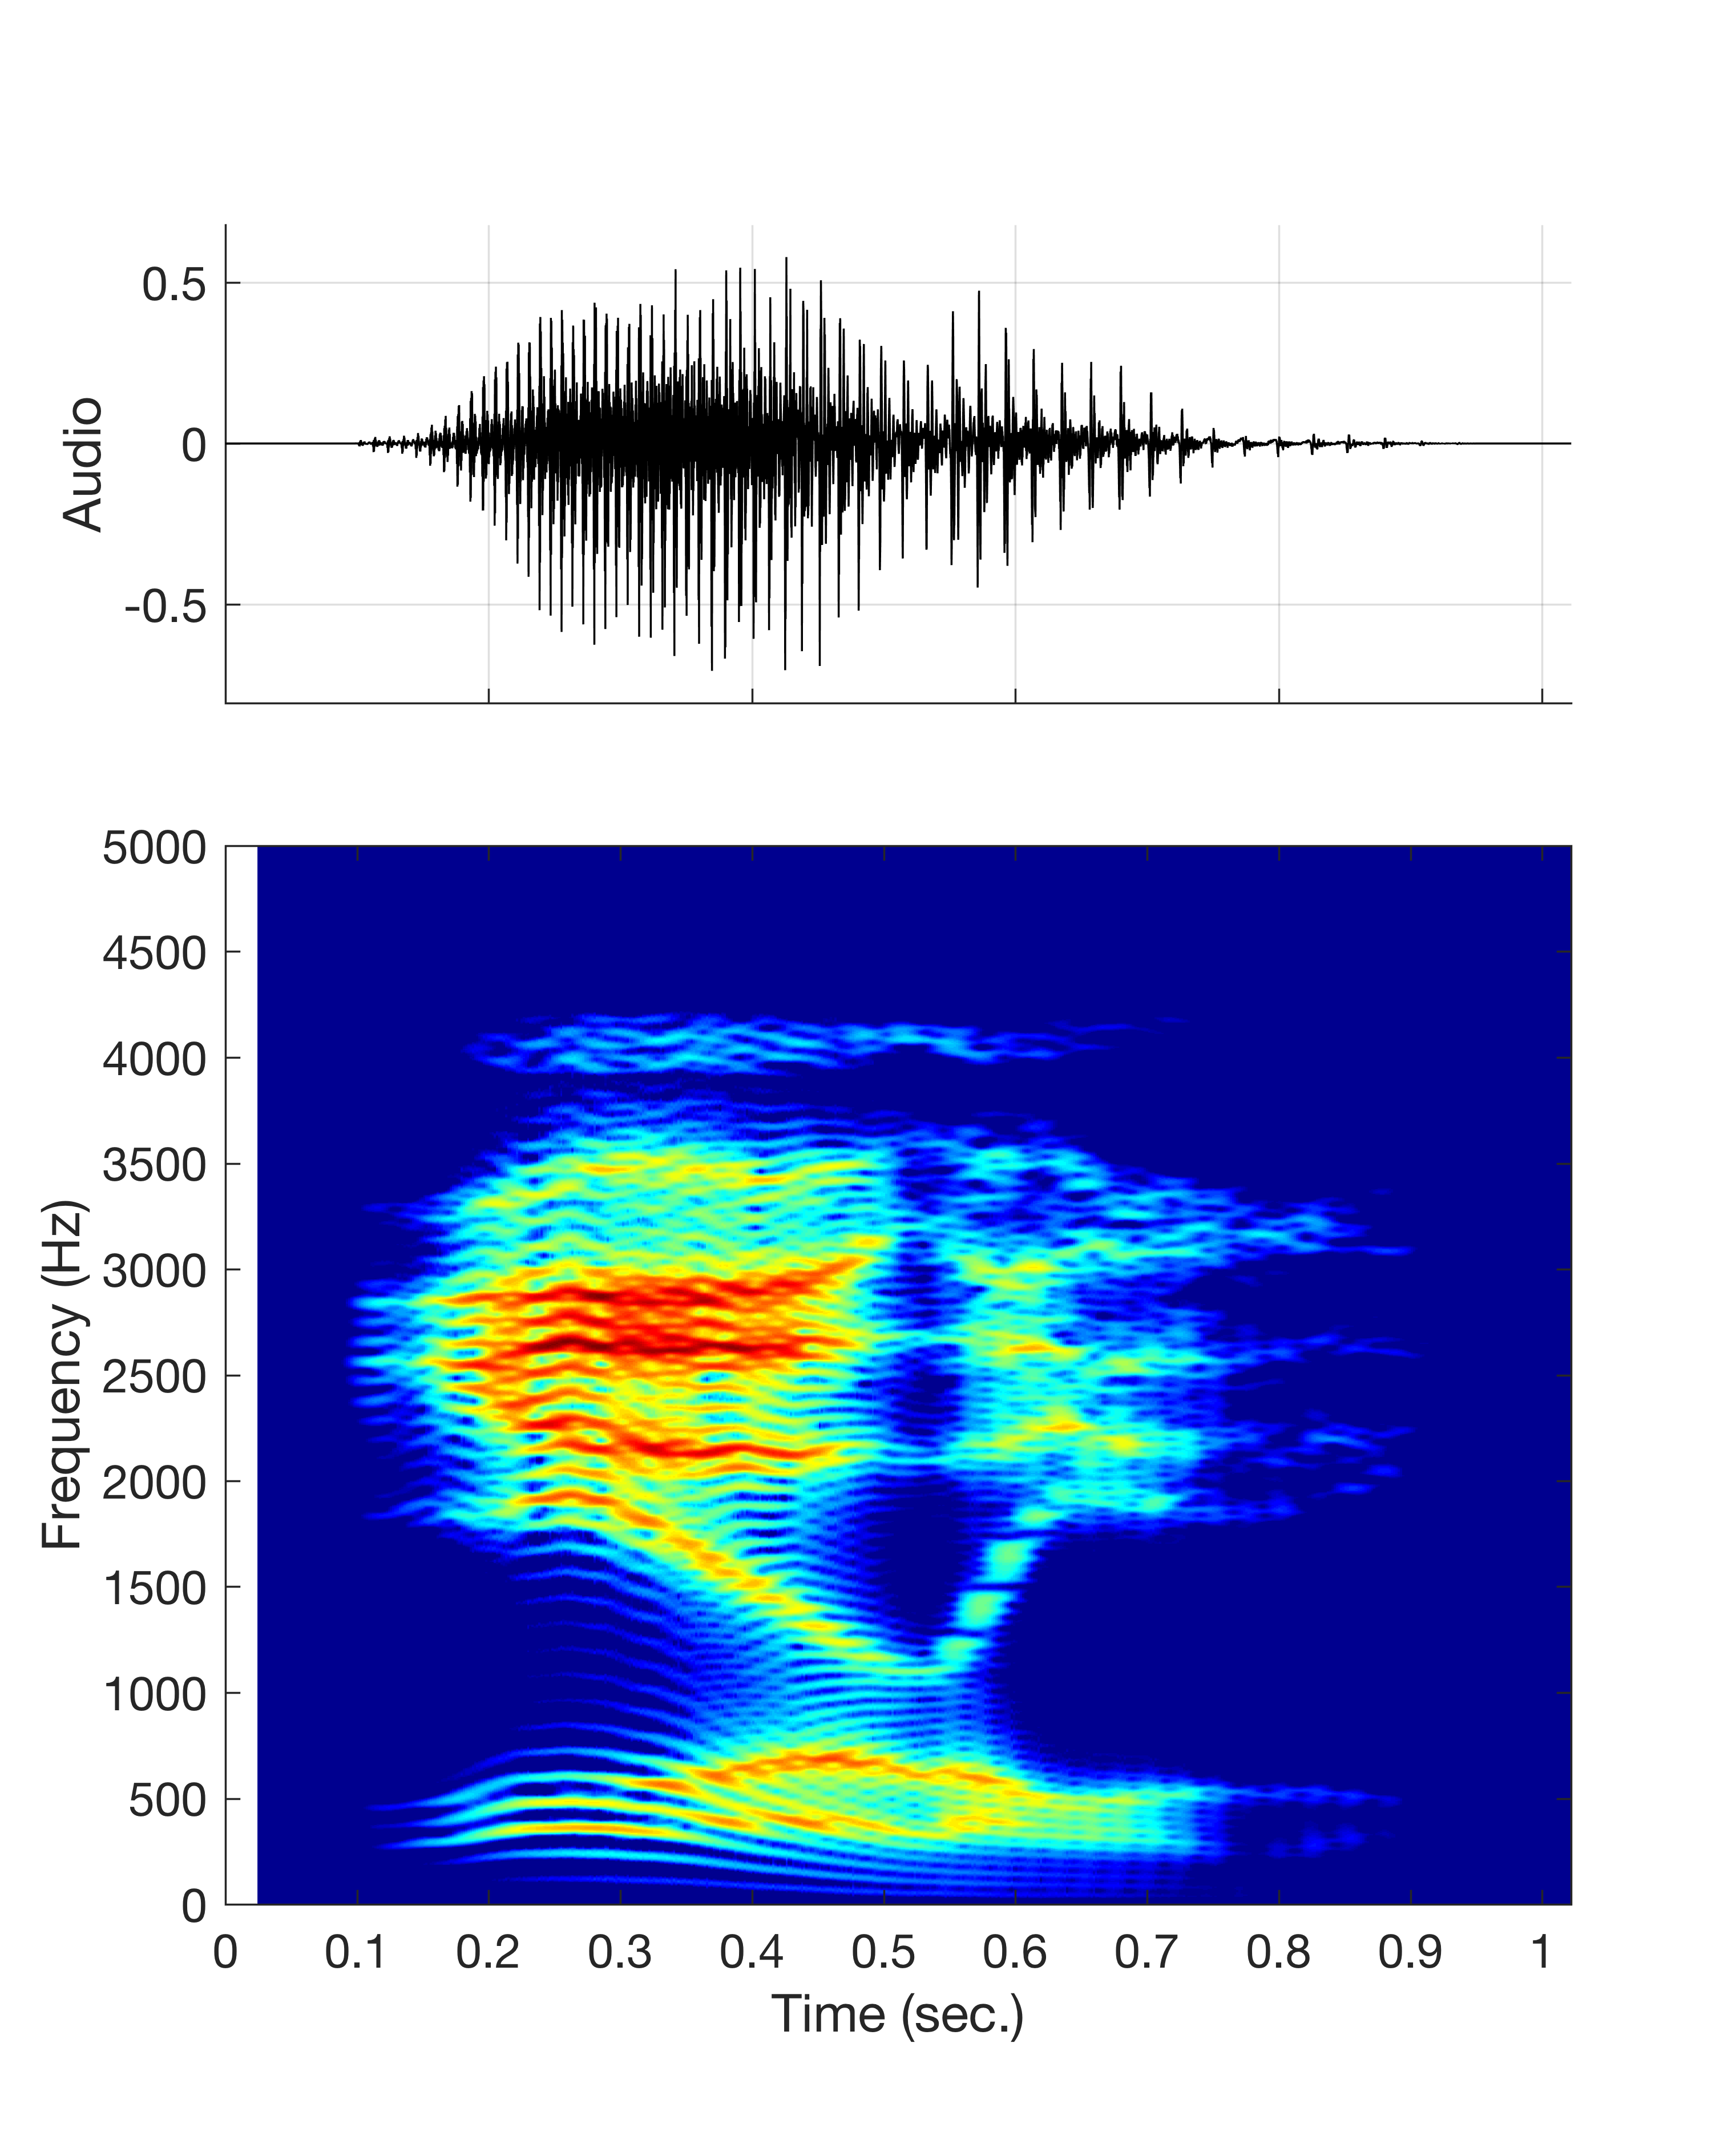
Laurel or Yanny?
Human speech recognition is not 100%.

Slide 11
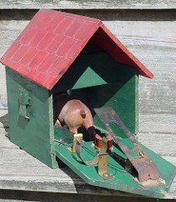
Speech Recognition: Listening Machines
First speech recognizer
The first machine that recognized speech was probably a commercial toy named “Radio Rex” which was sold in the 1920’s. Radio Rex was the first commercial toy to respond to voice commands.
Rex is a brown bulldog made of celluloid and metal that responds to its name by leaping out of its house. The dog is controlled by a spring that is held in check by an electromagnet.
The electromagnet is sensitive to sound patterns containing acoustic energy around 500 Hz, such as the vowel in "Rex."

Slide 12
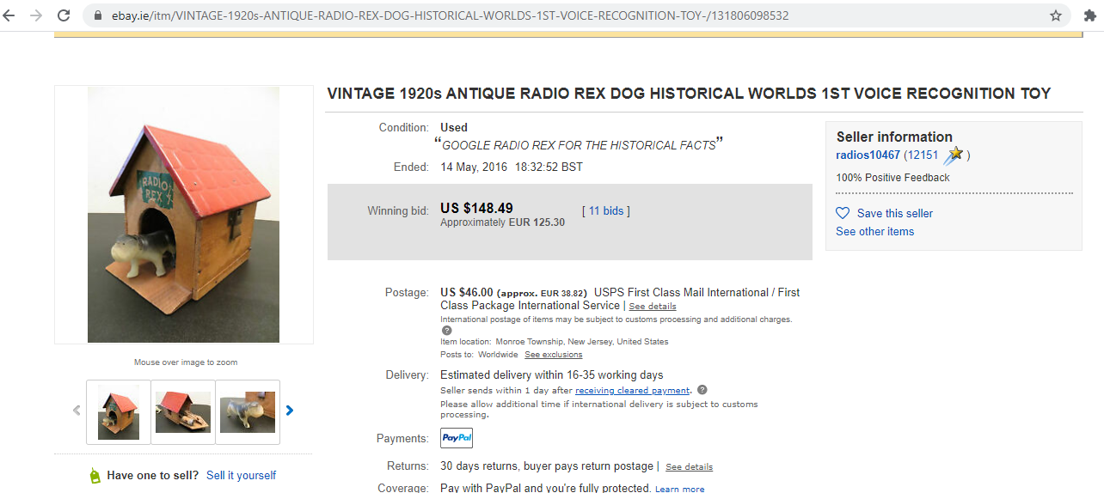
Speech Recognition: Listening Machines
First speech recognizer
“How Siri and Alexa trace their origins to a toy called Radio Rex”

Slide 13
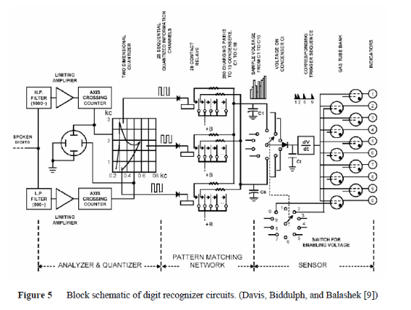
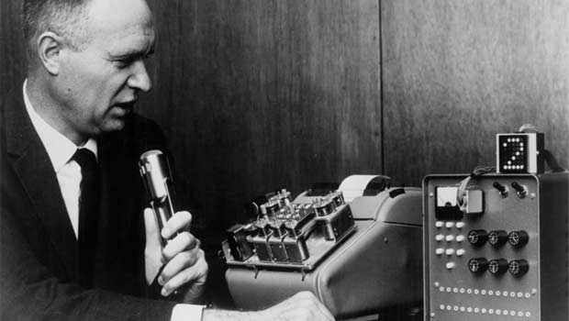
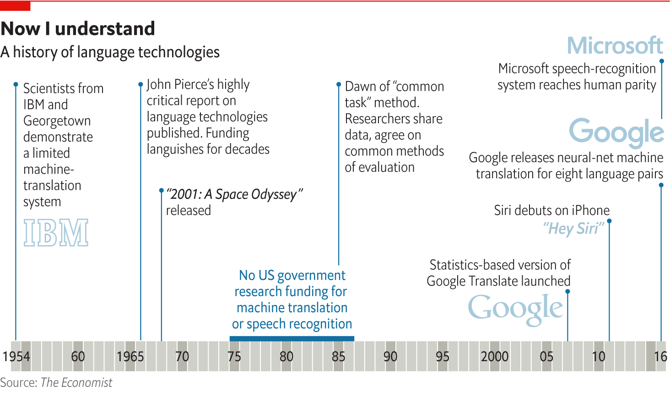
First Speech Recognizers
In 1952, Davis, Biddulph, and Balashek of Bell Labs built a system for isolated digit recognition (AUDREY, 6 feet tall circuitry).
In 1962, William C. Dersch (IBM) unveiled the Shoebox—a machine that could do simple math calculations via voice commands.

Slide 14
An Irony

Slide 15
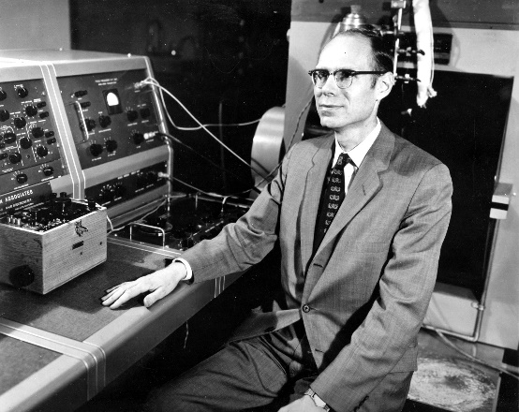
Whither Speech Recognition? The Journal of the Acoustical Society of America, Vol. 46, No. 4, (Part 2), 1049-1051, October 1969 J.R. PIERCE, Bell Telephone Laboratories, Inc., Murray Hill, New Jersey 07971
J.R. Pierce
developed jointly the concept of pulse code modulation (PCM) with his Bell Labs colleagues Barney Oliver and Claude Shannon.
He supervised the Bell Labs team which built the first transistor

Slide 16
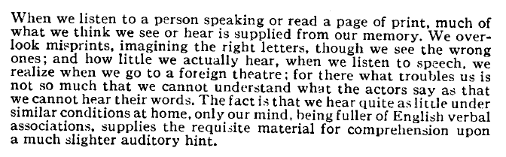
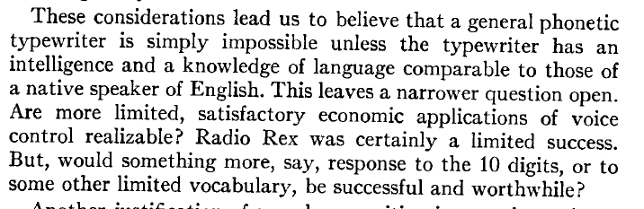
Whither Speech Recognition? The Journal of the Acoustical Society of America, Vol. 46, No. 4, (Part 2), 1049-1051, October 1969 J.R. PIERCE, Bell Telephone Laboratories, Inc., Murray Hill, New Jersey 07971
Notes:
John Pierce

Slide 17
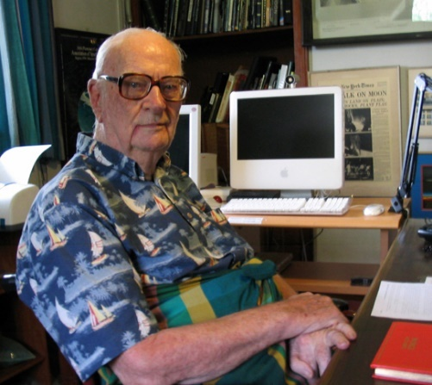
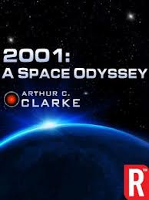
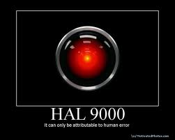
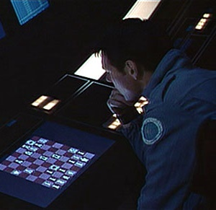
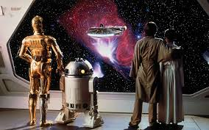
Speech in Sci-Fi
HAL is a fictional artificial intelligence character in Arthur C. Clarke's Space Odyssey series. HAL listens, talks, sings, reads lips, plays chess, and solves problems!!
HAL
IBM
C-3PO is fluent in over six million forms of communication
Notes:
IRONY:
He is a fiction writer, a friend of John Pierce. He wrote a novel, with a robot name HAL. (IBM shift one letter). He wanted to challenge IBM to see if they can do recognition, or singing synthesis or even play chess. Now many people do, even at SUTD. Scientist did not believe, but fiction writer did. And at the end, the fiction writer was correct ☺
First appearing in the 1968 film 2001: A Space Odyssey, HAL (Heuristically Programmed ALgorithmic Computer) is a sentient computer (or artificial general intelligence) that controls the systems of the Discovery One spacecraft and interacts with the ship's astronaut crew.

Slide 18
When it comes to AI and machine learning….
We’re only limited by our imagination!

Slide 19

Old Wisdom
Acoustic Modeling
(the ear)
Speech
Acquisition
(to pay attention)
Language modeling
(the heart)
Chinese character ‘to listen’
Notes:
Chinese character: to listen, has been used for 4000 years until today. It says that to listen, you need to have the ear, eyes (attention), and the heart. In the ancient time, people already knew you need an eye, ear and heart to make sense of the meaning.

Slide 20

ASR Application: Medical Documentation
In the past, 250,000 US citizens die each year from medical errors. 90% of practice managers feel patient documentation is a burden on their practice.
Statistics shows that 1/6 of doctors’ time is spent on admin.
The most useful speech recognition is in hospitals. In most of the hospitals in US, doctors are require by law to record the diagnosis of patients for legal and insurance purposes. In this process, speech recognition is required.
IDG Connect, Speech recognition tech still poised to ‘transform’ healthcare, March 15 2017
Nuance: https://www.nuance.com/healthcare.html

Slide 21
Speech Information Processing
Today, I’ll talk about some of the topics we do research here at ISTD Pillar of SUTD.
Speech Recognition
Voice Separation
Speech Synthesis and Generation
Voice Conversion

Slide 22

Voice Separation
In human speech communication, a listener can easily capture the desired speech, even from complex background noise and competing speech.
With advanced AI-based algorithms, we expect machines to do the same.
MixType | Speaker | Mixed | Separated
Male-Female | Trump
 | Hillary
https://www.youtube.com/watch?v=SLWgV8trxKQ

Slide 23
Speech Information Processing
Today, I’ll talk about some of the topics we do research here at ISTD Pillar of SUTD.
Speech Recognition
Voice Separation
Speech Synthesis and Generation
Voice Conversion

Slide 24
Machine Learning Can Mimic Anyone’s Voice

Slide 25
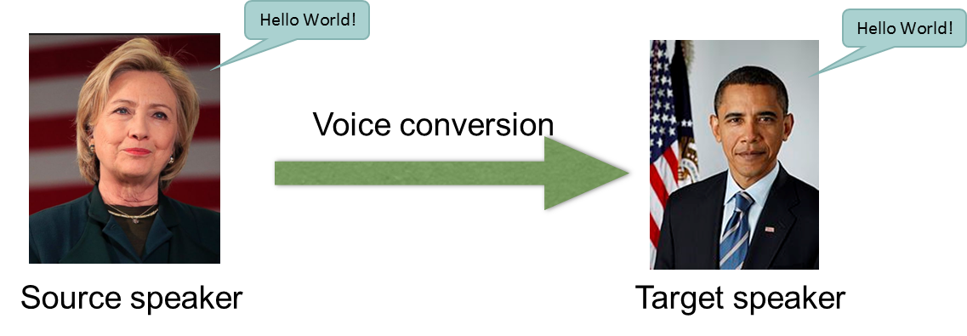
Voice Conversion
Voice conversion (VC) is a technique to modify the voice of one speaker to sound like it was pronounced by another speaker.
The success of voice conversion technology will open up tremendous opportunities for novel innovative products and services.

Slide 26
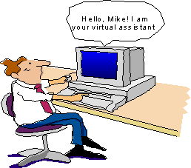

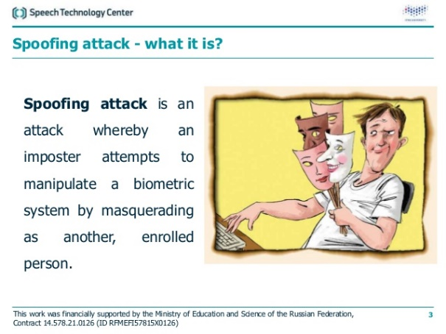
Voice Conversion
Voice conversion applications:
Personalized conversational assistants
Talking heads, social robots
Spoofing attacks,
Personalized Text-to-Speech (TTS),
Dubbing of movies and games,
Speech to Singing,
…
Notes:
The vc technology has advanced rapidly over the last few decades due to its application. Here you can see some of the application areas.

Slide 27
Voice Conversion Examples
FRAMEWORK | Original Target | Original Target
GAN with WORLD vocoder
GAN with speaker independent WaveNet vocoder
GAN with speaker adapted WaveNet vocoder
GAN with WaveNet vocoder as residual compensation [*]
[*] B.Sisman, M. Zhang, S. Sakti, H. Li, S. Nakamura ‘Adaptive WaveNet Vocoder for Residual Compensation in GAN-Based Voice Conversion’ IEEE SLT 2018

Slide 28
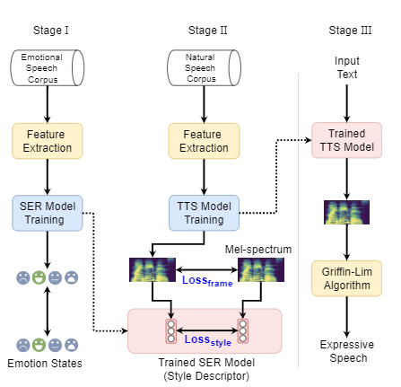
Text-to-speech synthesis
Text-to-speech synthesis (TTS) is a technology of converting written text into speech (human voice).
The resulted speech is expected to sound natural, expressive and emotionally rich.
An example of a TTS framework in three stages: Stages I and II for training, and Stage III for run-time inference.

Slide 29


Voice Conversion vs TTS
VC requires considerably less training data than TTS!
VC training data for high quality voice: 10 minutes
TTS training data from scratch: 10 hours
Hello
SUTD
Hello
SUTD
Voice Conversion
‘Hello
SUTD’
Text to Speech
Synthesis

Slide 30
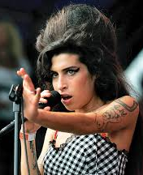
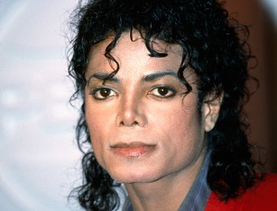

Interesting VC/TTS Applications (Real-life)
Regenerating voices of actors/actresses who are no longer alive
Regenerating voices of people who’ve lost their voice to old age or illness (very good news for elderly!)
Medical applications: Voice restoration systems, training interfaces for speech pathologies
Personalized human computer interfaces:
generating mother’s voice in educational software ☺

Slide 31
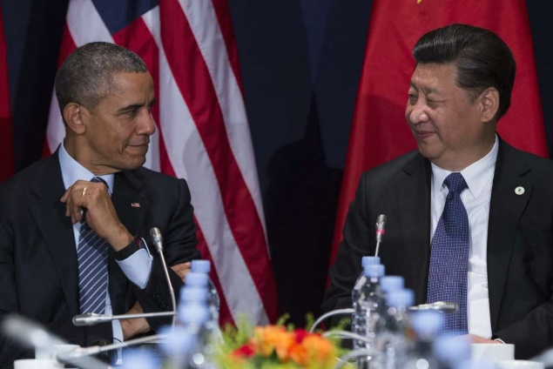

How about cross-lingual VC?
Let’s image that source and target speakers use different languages.
Is it still possible to find a mapping between them?
Challenge: mapping between 2 speakers from different phonetic systems (with no bilingual data)
VC
Barack Obama
(English)
Xi Jinping
(Mandarin)

Slide 32
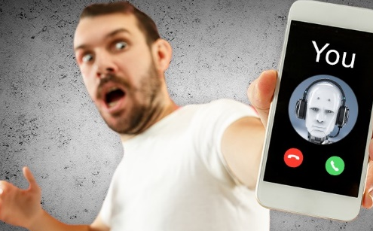
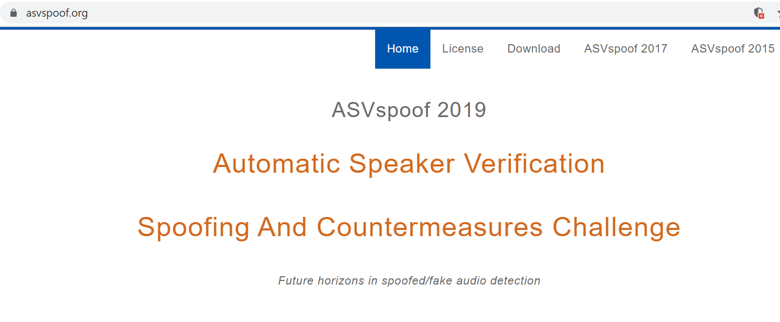
Risk of Voice Conversion
Possibility of VC being used for spoofing?
Real time voice conversion makes it possible for someone to speak with your voices.
Is it safe? Should we stop the VC research?
We shouldn’t stop. ☺ So many useful applications for our society to make life better and easier!
Things that we can do?
Collaborate with anti-spoofing
Kitchen knife? (according to Japanese speech scientists)

Slide 33
Conclusion Speech Information Processing
Speech Production
Speech Perception and Psychoacoustics
Speech Analysis
Speech Coding
Speech Enhancement
Speech Recognition
Speech Synthesis and Generation
Voice Separation
Voice Conversion
Acoustic Modelling
Language Modelling
Discourse and Dialogue
Speech Understanding

Slide 34

Thanks for listening!
I’m always looking for motivated students who are interested in speech & ML research.
Contact: berrak_sisman@sutd.edu.sg

